Slide 1
Artist Nidhi Chanani
Everyday Love with Nidhi Chanani

Slide 2
“When I decided to pursue art, I simply wanted to make people happy. I began to create an illustration every day and share it with friends and family, and I called that everyday love. To share the moments from a day that make you smile. I see it as a way to connect with an image that feels like coming home.”
- Nidhi Chanani
http://www.youtube.com/watch?v=zruE3sTGRKM

Slide 3
Nidhi Chanani is a freelance artist that works and creates in San Francisco. She uses small everyday moments of happiness to represent in her digital artwork, that she can then share to spread love and happiness.

Slide 4
Notes:
What do you notice about her style?

Slide 6
Notes:
Do you notice anything about the couples in Nidhi’s artwork? Nidhi represents interracial couples in her artwork because she is in an interracial marriage. She represents a group that is often forgotten and not visually represented.

Slide 7
Notes:
More examples of interracial couples in Nidhi’s artwork

Slide 8
Notes:
Nidhi also uses animals as characters in her artwork. For your self portraits, you could consider turning yourself into an animal that represents you.

Slide 9
Assignment:
On Thursday you will be creating cards for each other, using Nidhi’s style. Your card should:
-depict something that makes you happy
- contain a positive message to another classmate
Next week we will be working on a collaborative mural. Each section will be worked on by 2-3 people. The teachers will work on the background designed by you, while every students will make a self portrait in Nidhi’s style.

Slide 10
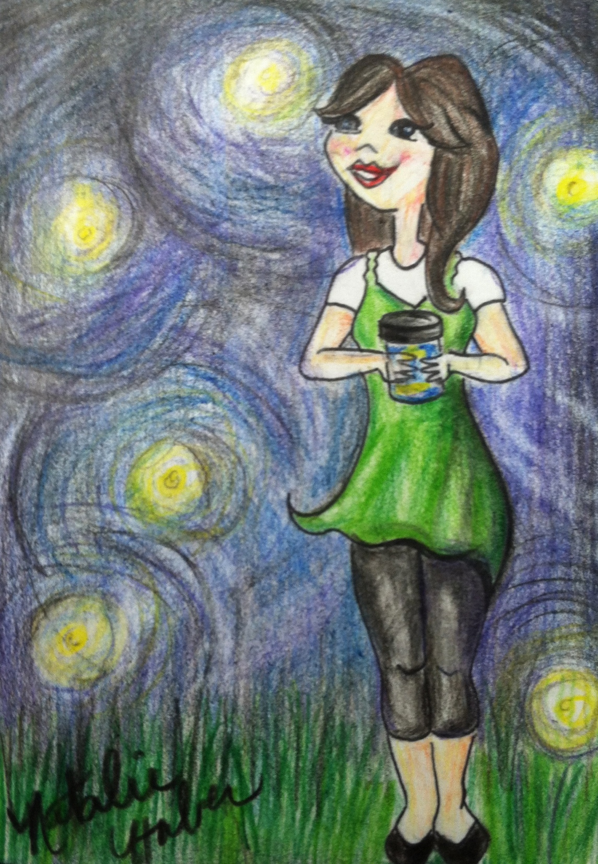
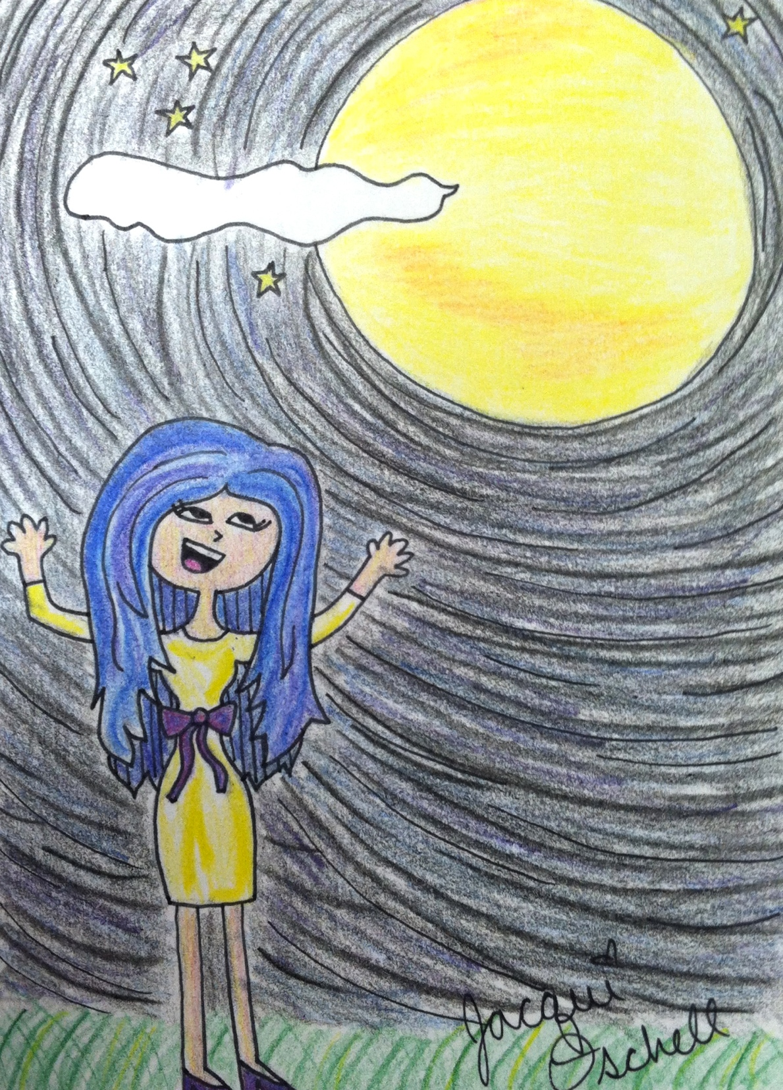
What makes you happy?
Things that make Ms. Huber happy…
finding flowers
getting mail
looking through old photos
sitting near the water during sunset
fireflies
Things that make Ms. Oschell happy…
finding a praying mantis
the first snowfall of the season
finding sea glass on the beach
a full moon
taking a nap in the sun
Notes:
Happiness lists should be about little moments that make you happy. Encourage students to get away from technology and material items as they create a list of at least 5 things or moments that make them happy. They should start to sketch these moments out on paper.

